Slide 1

Real Estate Price Prediction App
David McCain
Dev10 - Genesis10

Slide 2

Key Features
View Property Details
Get Price Prediction
Save Prediction History
Users can search through existing properties and view the location, price, etc. features
Users can view the predicted price along with a breakdown of contributing factors
Authenticated users can save property price predictions based on various features
NavBar Layout: Home Page | Properties List | Price Prediction | Prediction History | About Us | Contact Us

Slide 3
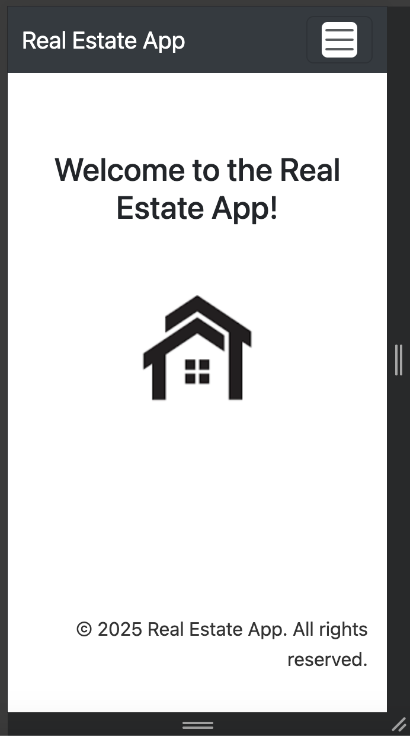
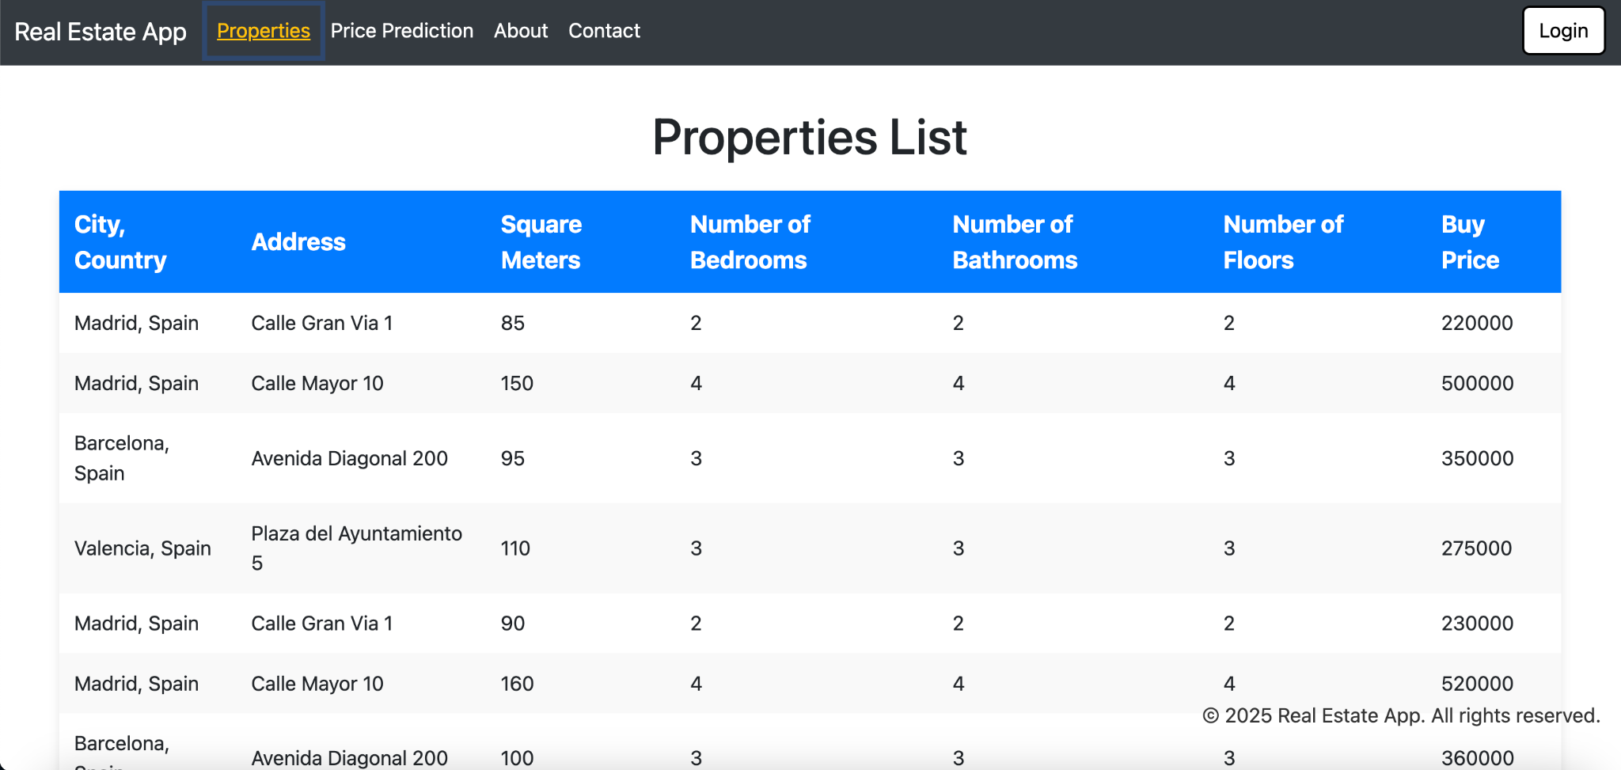
App Compatibility: Phone + Desktop

Slide 4

Technologies
Used...
(Mostly obtained from within dependency requirements)

Slide 5
Frontend
Backend
Machine Learning
Authentication
React, Bootstrap, JavaScript, JavaScript XML, HTML, CSS, Vite
Python, FastAPI, Pydantic, SQLAlchemy, PyMySQL, MySQL, Uvicorn, Starlette
Numpy, Pandas, Scikit-learn, (Jupyter Notebooks for analysis)
FastAPI Security (OAuth2), Jose (jwt), Passlib & Bcrypt (hash), Python-dotenv

Slide 6
Python Database Frontend
Python Routers - endpoints
JavaScript API - response
Pydantic Models - query
SQLAlchemy Schema - returned
MySQL Database - obtain

Slide 7
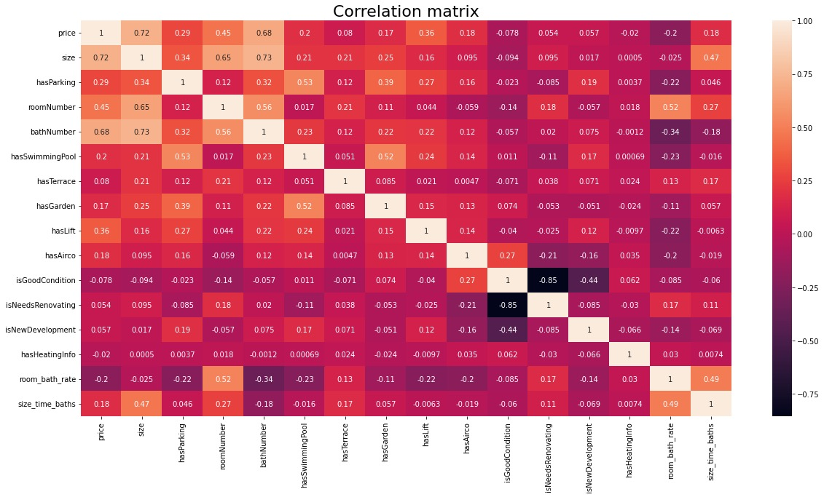

Slide 8
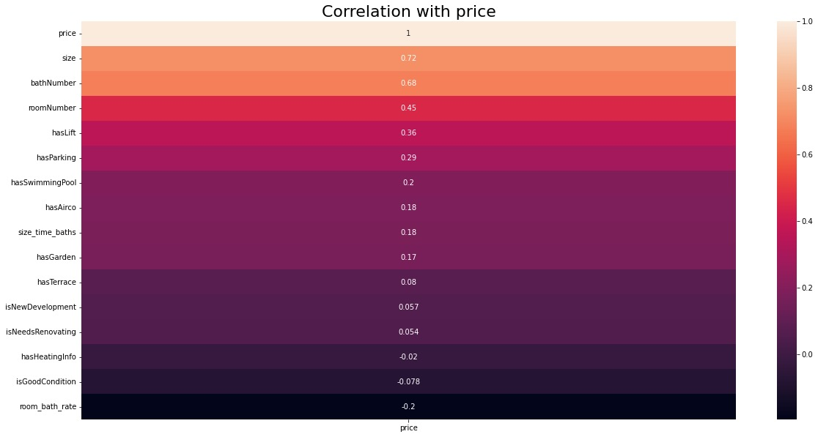

Slide 9
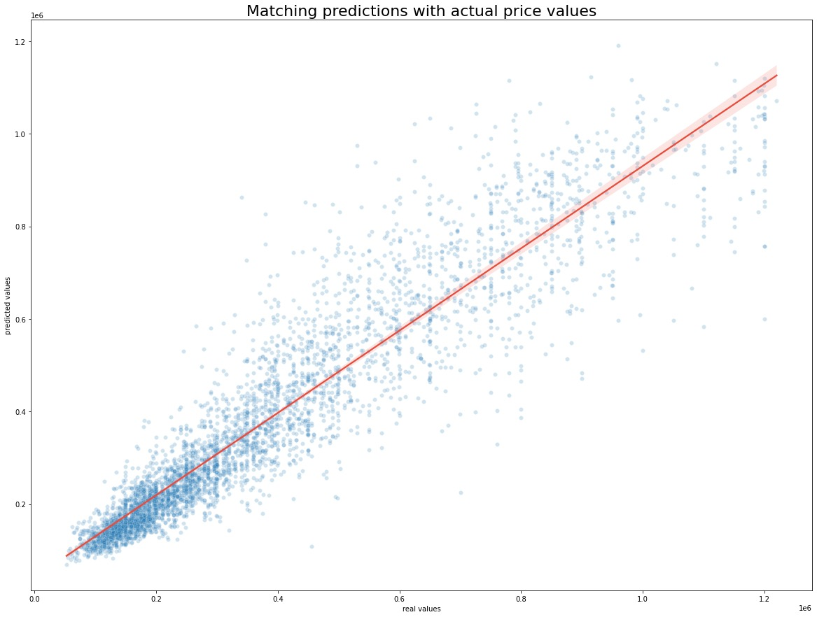
Note the trend for the AI model: it becomes much less accurate for outliers (ie. very expensive houses)

Slide 10
Future Updates
Differentiate between roles (users, buyers, sellers, etc.) and allow owners to post houses/apartments into the properties table.
Add the ability for users to search and filter through the properties list based on desired features.
Integrate more advanced AI/ML models for better predictions across various locations - expand beyond Madrid, Spain.
Enable export of price predictions and extensive property details to PDF/Excel formats.
Allow realtors to list pictures of properties they are selling/renting.

